Slide 1
STRUCTURE TENSOR TRACTOGRAPHY
By Manoj Kumar Cebol Sundarrajan 1620546
Under Guidance of Dr. David Mayerich University of Houston

Slide 2
Introduction
Data visualization technique proposed by Srijani Mukherjee of UH
Dense data are hard to visualize
Data is described by tensors
The data is solved to get eigen vectors
We use Tractrography to trace the fibers using the vectors.

Slide 3
A Dense kidney data

Slide 4
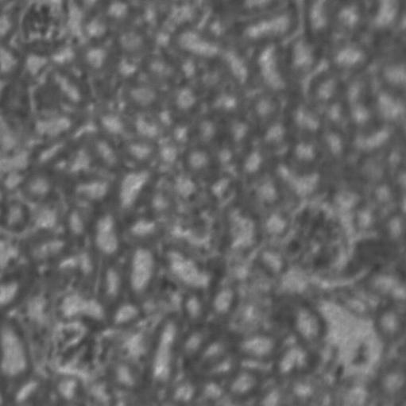
The data I will be working on
A 511 * 511 subset of previous image

Slide 5
Methodology
Calculate partial derivatives
Calculate structure tensors
Blur the structure tensors
Calculate Eigen vectors
Apply tractography

Slide 6
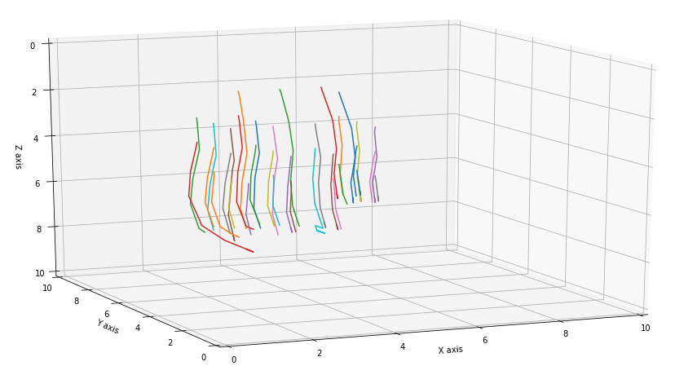
Result
A small subset of fibers obtained by plotting in python

Slide 7
Timing for CPU
93 files
time taken to read files : 2334.12 ms time taken to calculate partial derivatives : 958.07 ms time taken to calculate Tensor field : 1065.36 ms time taken to apply Padding : 989.101 ms time taken to apply blur along x axis : 8522.31 ms time taken to apply blur along y axis : 8853.27 ms time taken to apply blur along z axis : 3004.31 ms time taken to remove padding : 5260.06 ms time taken to calculate eigen vector : 30.2457 s (OpenMP 16 threads) time taken to do cryptography and writing it : 2.85251 s (OpenMP 16 threads)

Slide 8
Analysis
This timing would scale linearly for large dataset.
Not very efficient
Lots of opportunities to parallelize

Slide 9
Timing for GPU
93 files
time taken to read files : 3132.39 ms CPU (using Cimg Library) time taken to calculate derivates : 1.6585 ms GPU time taken to calculate tensors : 5.16634 ms GPU time taken to apply padding : 11.8064 ms GPU time taken to apply blurring along x direc : 9.19501 ms GPU-SHMEM time taken to apply blurring along y direc : 8.7159 ms GPU-SHMEM time taken to apply blurring along z direc : 5.9849 ms GPU-SHMEM time taken to remove padding : 11.512 ms GPU computing Eigen vectors accelerated using OpenMP time taken to calculate eigen vector : 30203.1 ms CPU-OPENMP(Used 16 threads) time taken to do tractography : 69.4649 ms GPU

Slide 10
Analysis
Very large speedup
Highly suitable for very large datasets
Major bottleneck was data transfers to GPU
Reduce data transfers as much as possible

Slide 11
Code
https://github.com/manoj1511/ECE_6397-GPU_Programming/tree/master/final_project

